Slide 1

How to work with JavaScript Object Notation (JSON)
Notes:
Session: Ghi số thứ tự session trong môn học
Session Name: ghi tên của session sẽ dạy

Slide 2
Objectives
An introduction to JSON
How to work with JSON in JavaScript
The Task Manager application
Notes:
Mô tả nội dung mà học viên phải đạt được khi kết thúc môn học này

Slide 3
An introduction to JSON
Notes:
Session: Ghi số thứ tự session trong môn học
Session Name: ghi tên của session sẽ dạy

Slide 4
The serialize and deserialize
When you want to send an object across network, you must convert them to the data then send the data over network. This process called serialize.
The application read the data to render an object. This process is called deserialize.
Only object’s data is serialized, not its method.

Slide 5
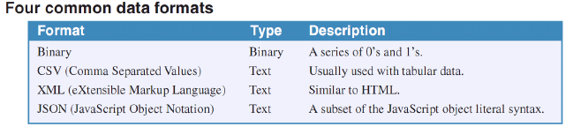
How data formats work
There is many way to data formats is used to serialize objects.

Slide 6
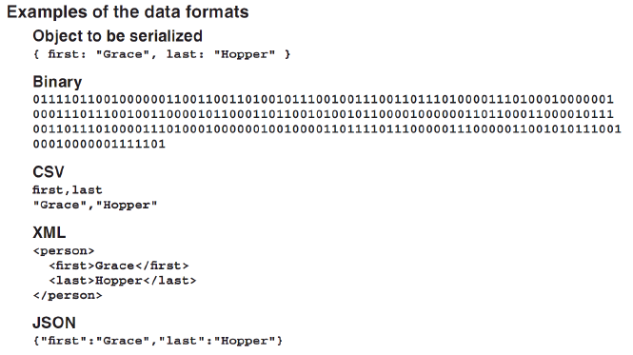
How data formats work (cont.)

Slide 7
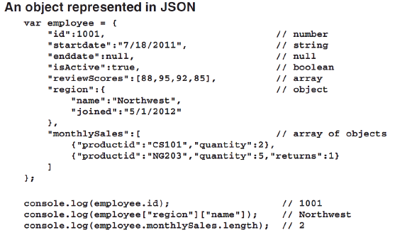
What JavaScript Object Notation (JSON) is
JSON is a data format for transferring and storing data that works especially well with JavaScript application.

Slide 8
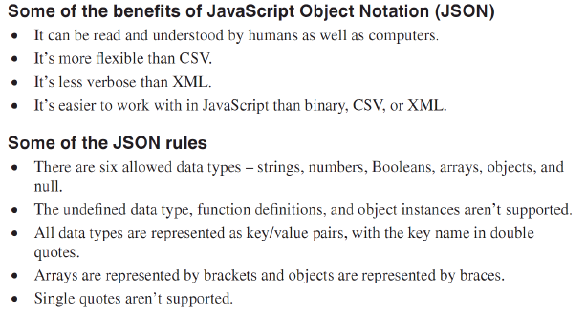
What JSON is (cont.)

Slide 9
How to work with JSON in JavaScript
Notes:
Session: Ghi số thứ tự session trong môn học
Session Name: ghi tên của session sẽ dạy

Slide 10
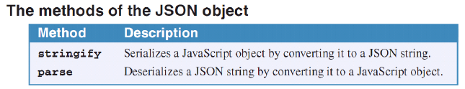
An introduction to the global JSON object
All modern browsers have a global JSON object that provide stringify and parse methods for working with native JSON objects and JSON strings.

Slide 11
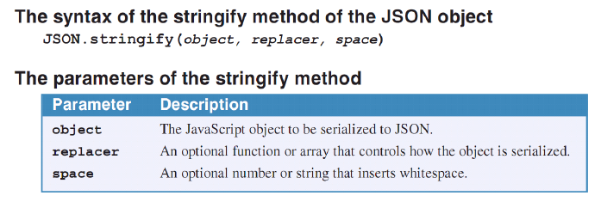
How to use stringify method of the JSON object
The stringify method of the JSON object converts the JavaScript object that’s passed to it to a JSON string.

Slide 12
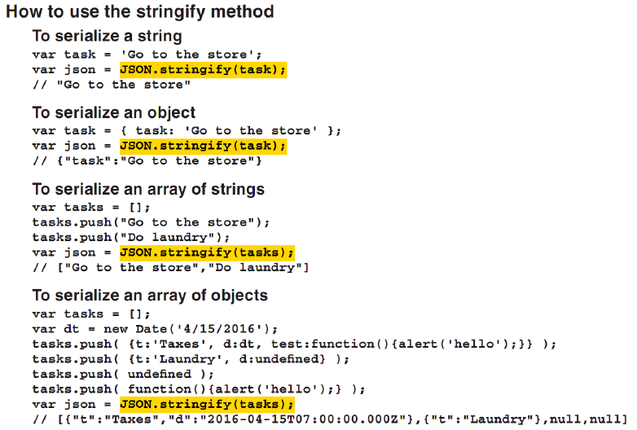
How to use stringify method of the JSON object (cont.)

Slide 13
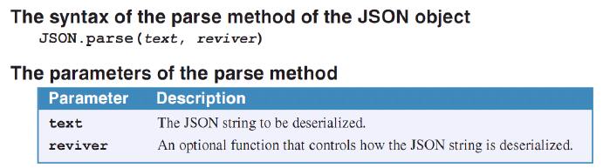
How to use parse method of the JSON object
The parse method of JSON object converts a JSON string to a JavaScript object.

Slide 14
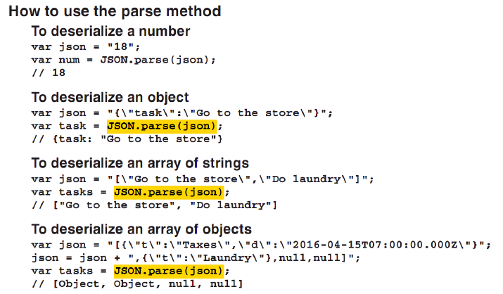
How to use parse method of the JSON object (cont.)

Slide 15
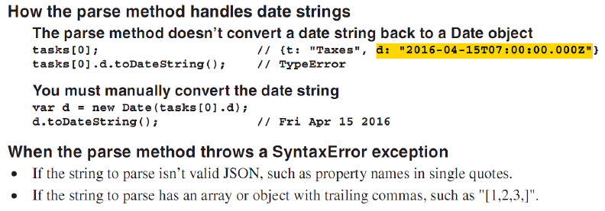
How to use parse method of the JSON object (cont.)

Slide 16
The Task Manager application
Notes:
Session: Ghi số thứ tự session trong môn học
Session Name: ghi tên của session sẽ dạy

Slide 17
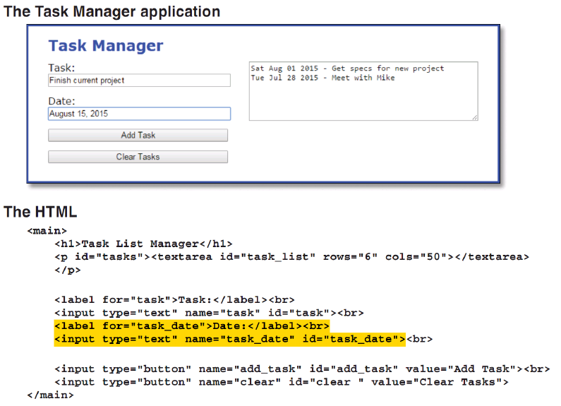
The Task Manager application

Slide 18
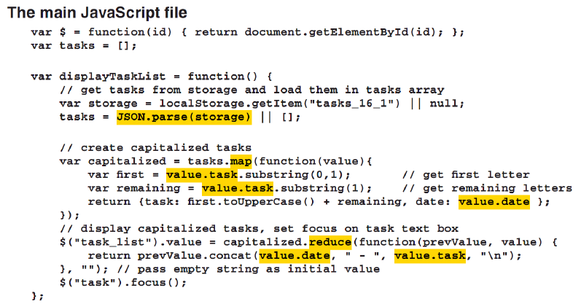
The Task Manager application (cont)

Slide 19
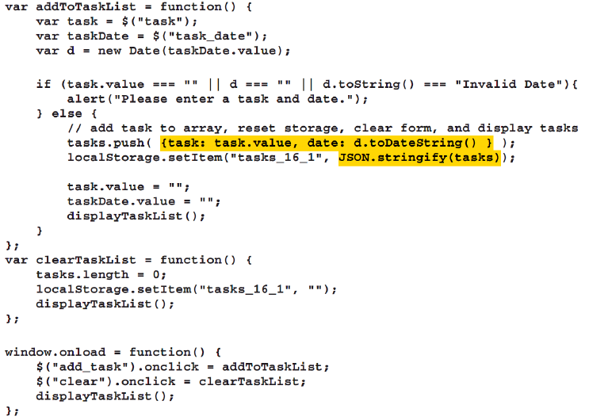


Slide 20
The End.

